Slide 1
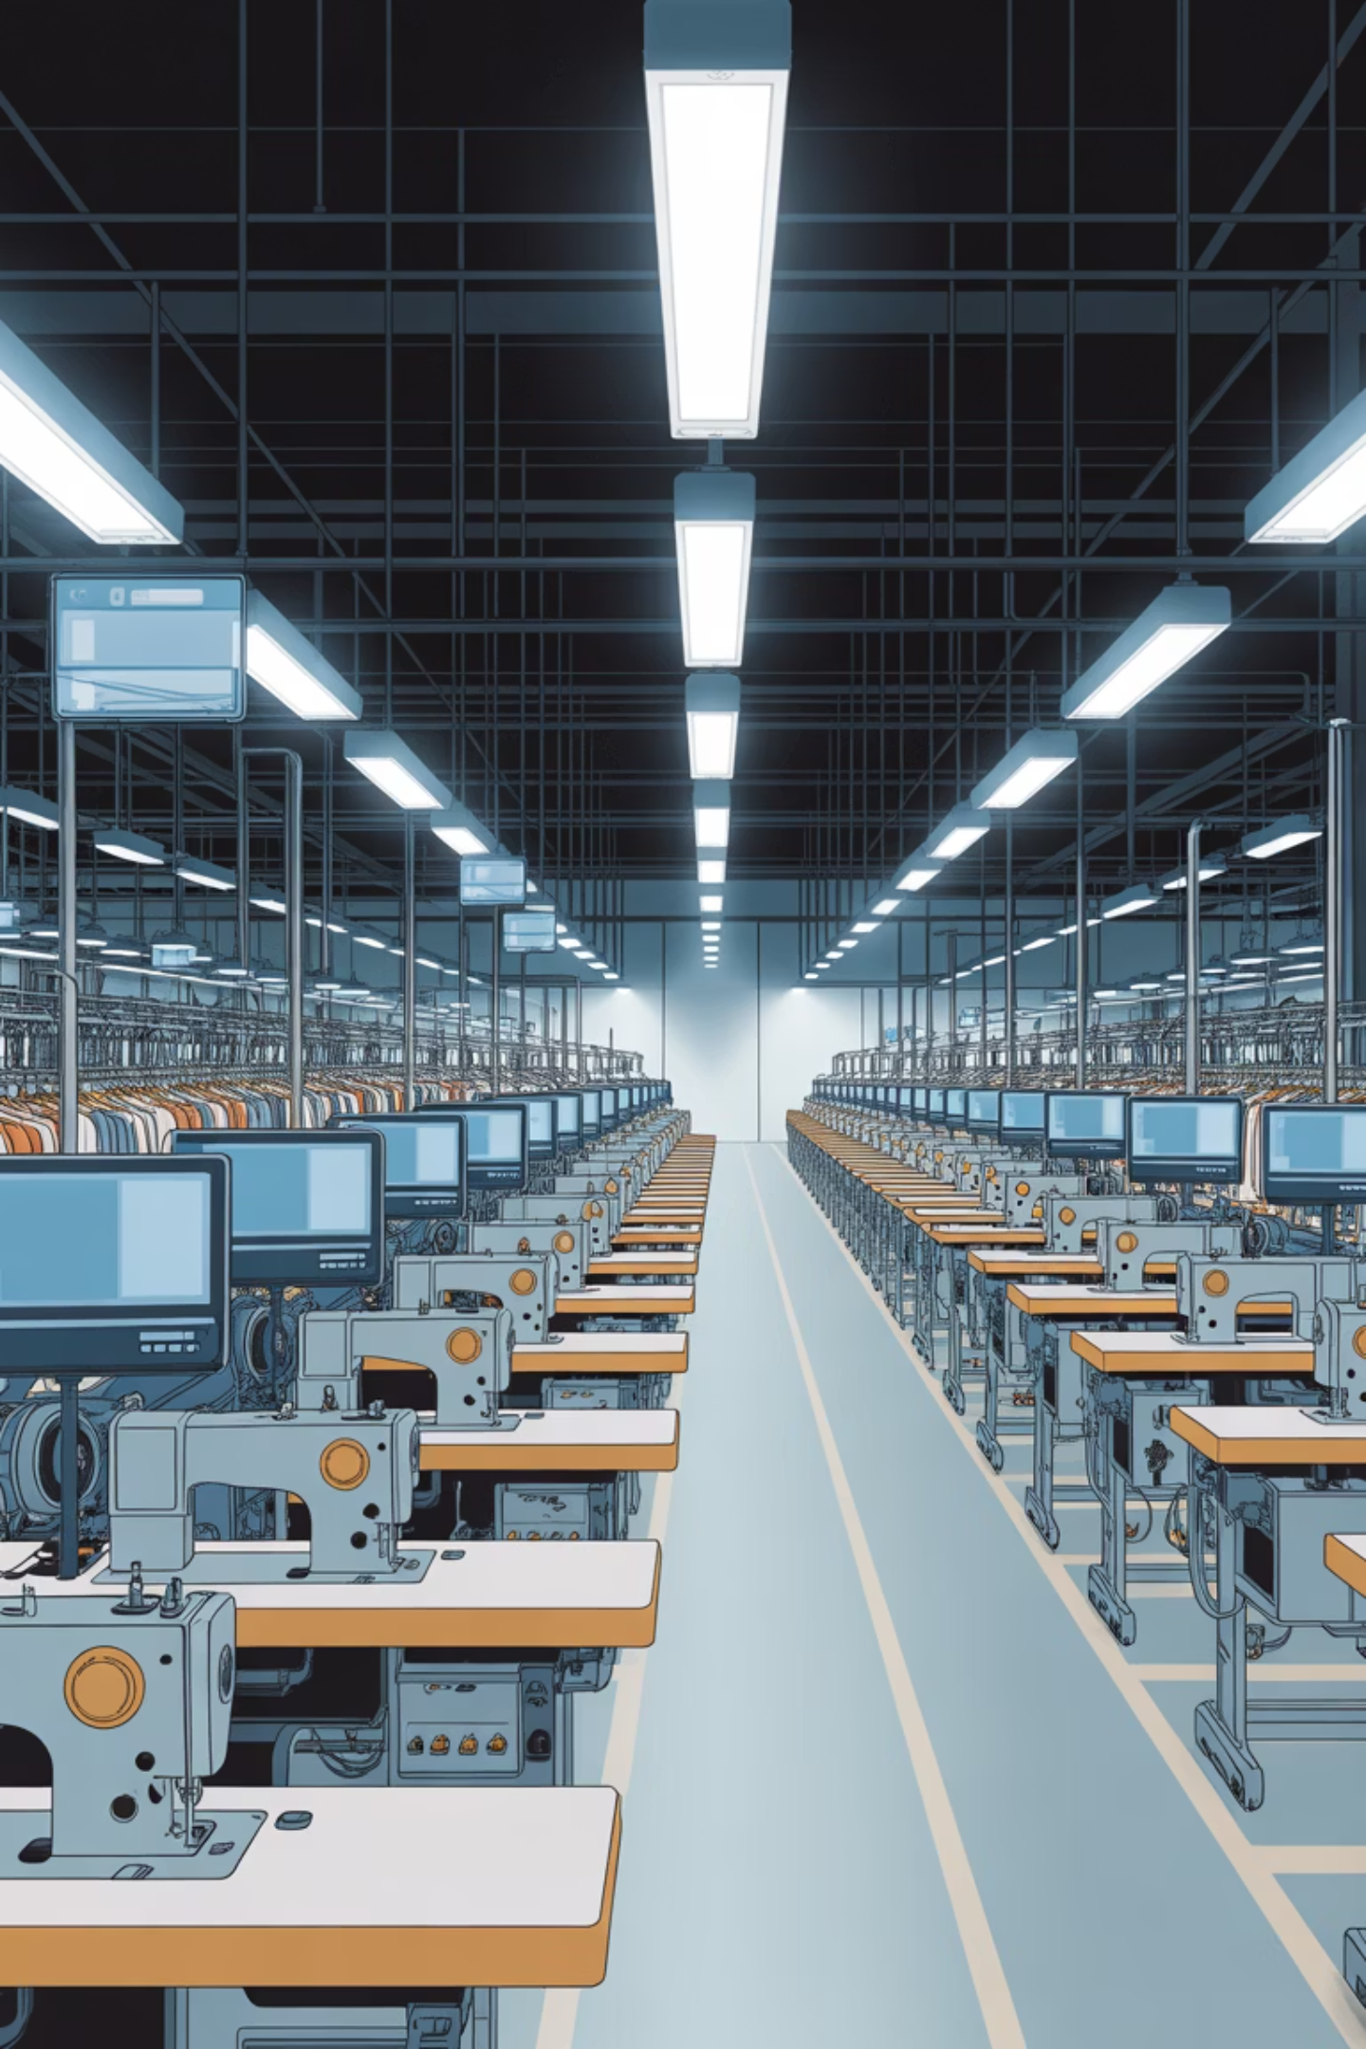
Smart Machine
Replacement System
Concord Apparel (Pvt) Ltd
EAD Group Project - Group B
22/02/2026
2025 | Faculty of Technology

Slide 2
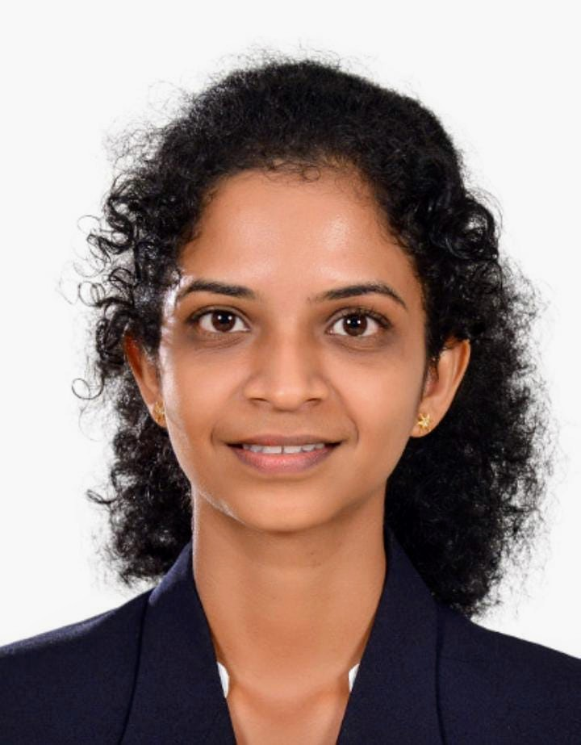
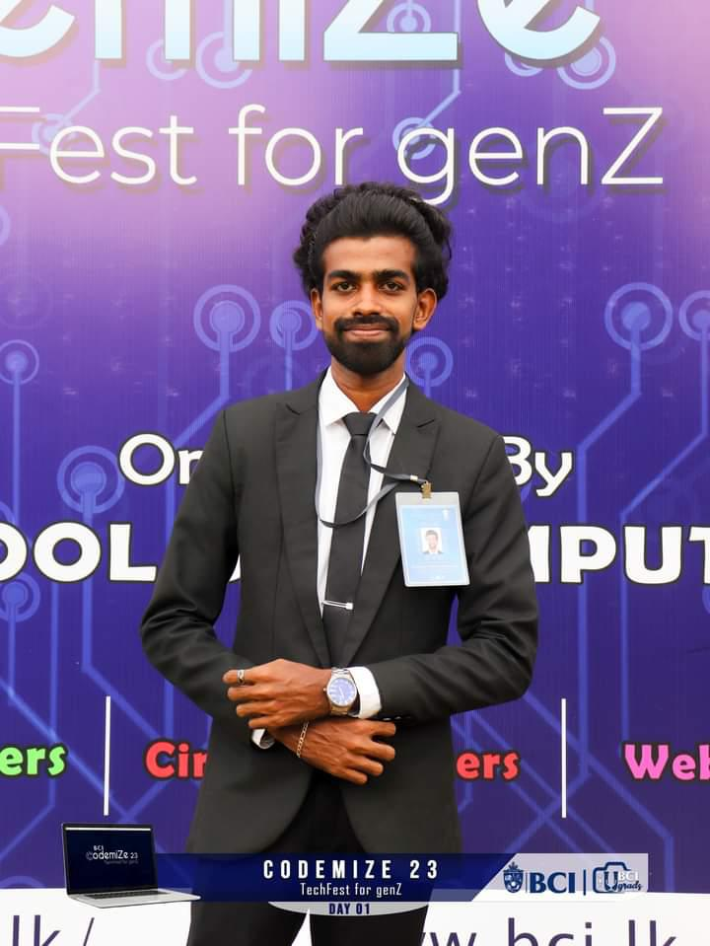
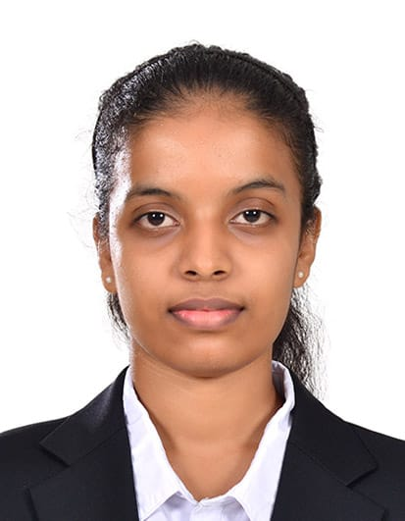



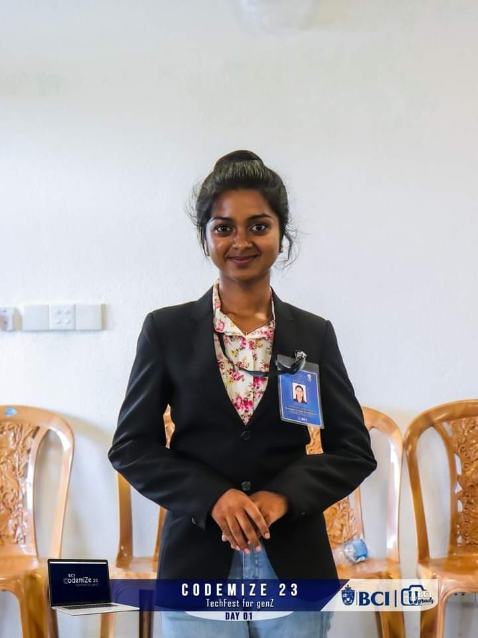

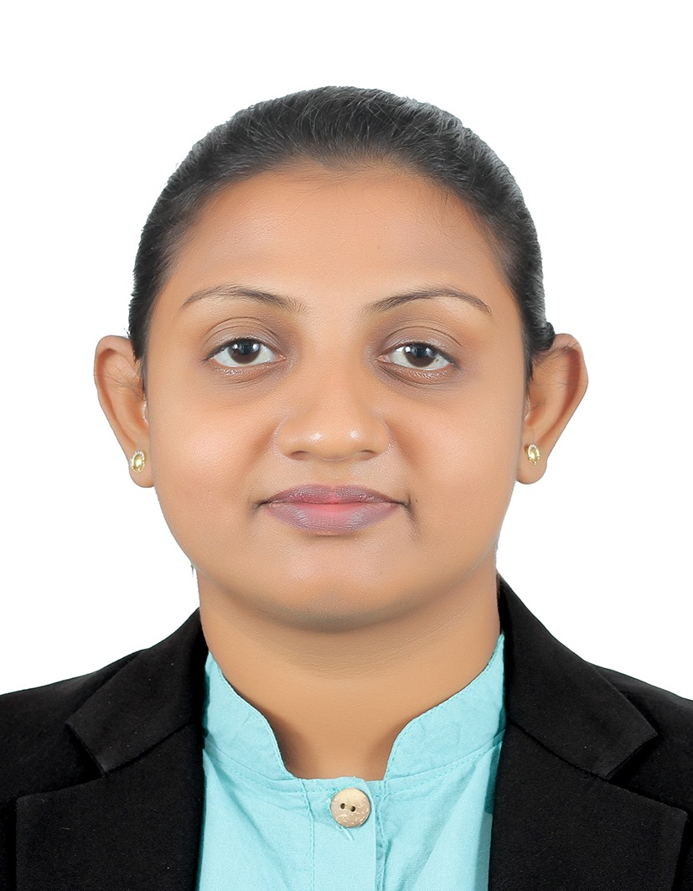
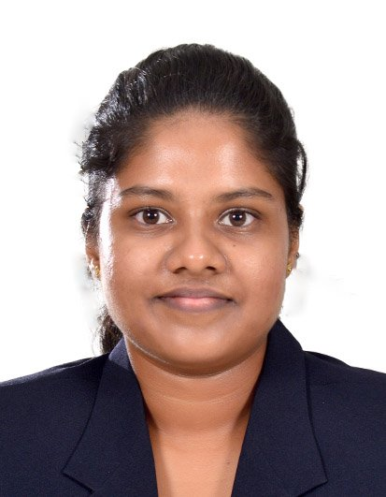

Team Members
Nirmalie Perera
Buddika Prabath
Prasansa Nawanjalee
Imal Udyog
Leader, BSIT221001
BSIT221027
BSIT221015
BSIT221025
Nuwan Seneviratna
Kavindu Pansilu
Tharushi Fernando
Rashmi Fernando
BSIT221016
BSIT221002
BSIT221003
BSIT221011
Rayani Fernando
Malki Perera
Nimna Devindi
BSIT221008
BSIT221013
BSIT221006

Slide 3
01
Introduction
06
System Overview
02
Proposed Solution
07
Functions of the System
Table of Content
03
Benefits of the System
08
Tools & Technologies
04
Aim of the Project
09
Team & Work Distribution
05
Objectives of the Project
10
Project Timeline — Gantt Chart

Slide 4
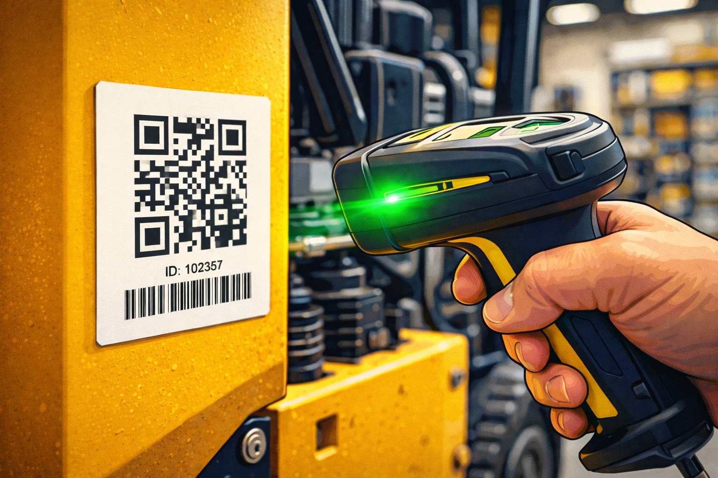
Introduction
The garment industry depends on sewing machines for continuous production. When machines break down and cannot be repaired, finding a replacement is time-consuming because there is no centralized system to check machine availability across stores.Our project introduces a QR code–based machine tracking system that allows technicians to scan a machine, view its details, and quickly find matching machines in nearby stores. This helps reduce downtime, transportation costs, and unnecessary new purchases.
Page | 1

Slide 5
Problem Statement & Difficulties
No Centralized System
No system exists to identify which stores have replacement machines. Staff must manually contact each store.
High Costs
Transporting machines from distant locations or purchasing new machines from outside incurs significant costs and delays.
Proximity Blindness
Nearby stores with available machines can be missed, leading to unnecessary long-distance transportation.
Page | 2

Slide 6
Proposed Solution
Implement a QR-Code Based Machine Management System
1
2
3
4
5
Scan QR Code
System Searches
Proximity Sort
Request Machine
CM Approval
Technician scans the faulty machine's QR code using mobile/tablet.
System queries database for matching machines available in stores.
Results sorted by distance using GPS coordinates of stores.
Technician selects and sends a request to Chief Manager.
Chief Manager reviews and approves the transfer request.
Page | 3

Slide 7
System Flow: Input → Process → Output
INPUT
PROCESS
OUTPUT
Machine QR Code
QR code scan & decode
List of matching machines
▶
▶
Technician request
Database query for matching machines
Nearest stores with contact info
Machine model / specs
Distance calculation (lat/lng)
Machine availability status
Store location data
Sort by proximity
Transfer request notification
Garment location data
Request & approval workflow
Approval/rejection notice
Page | 4

Slide 8
Benefits of the System
Cost Reduction
Time Saving
Location Awareness
Prevents unnecessary machine purchases by finding available matching machines from nearby stores first.
Instant QR-scan lookup eliminates manual phone calls to multiple stores, reducing downtime significantly.
Proximity-based search ensures the nearest store is always found first, minimizing transportation costs.
Streamlined Approval
Centralized Data
Scalability
Structured request and approval workflow ensures accountability and proper authorization through CM.
Single system for all machines, stores, and garment locations eliminates information silos.
New stores and machines can be easily added via QR generation at registration time.
Page | 5

Slide 9
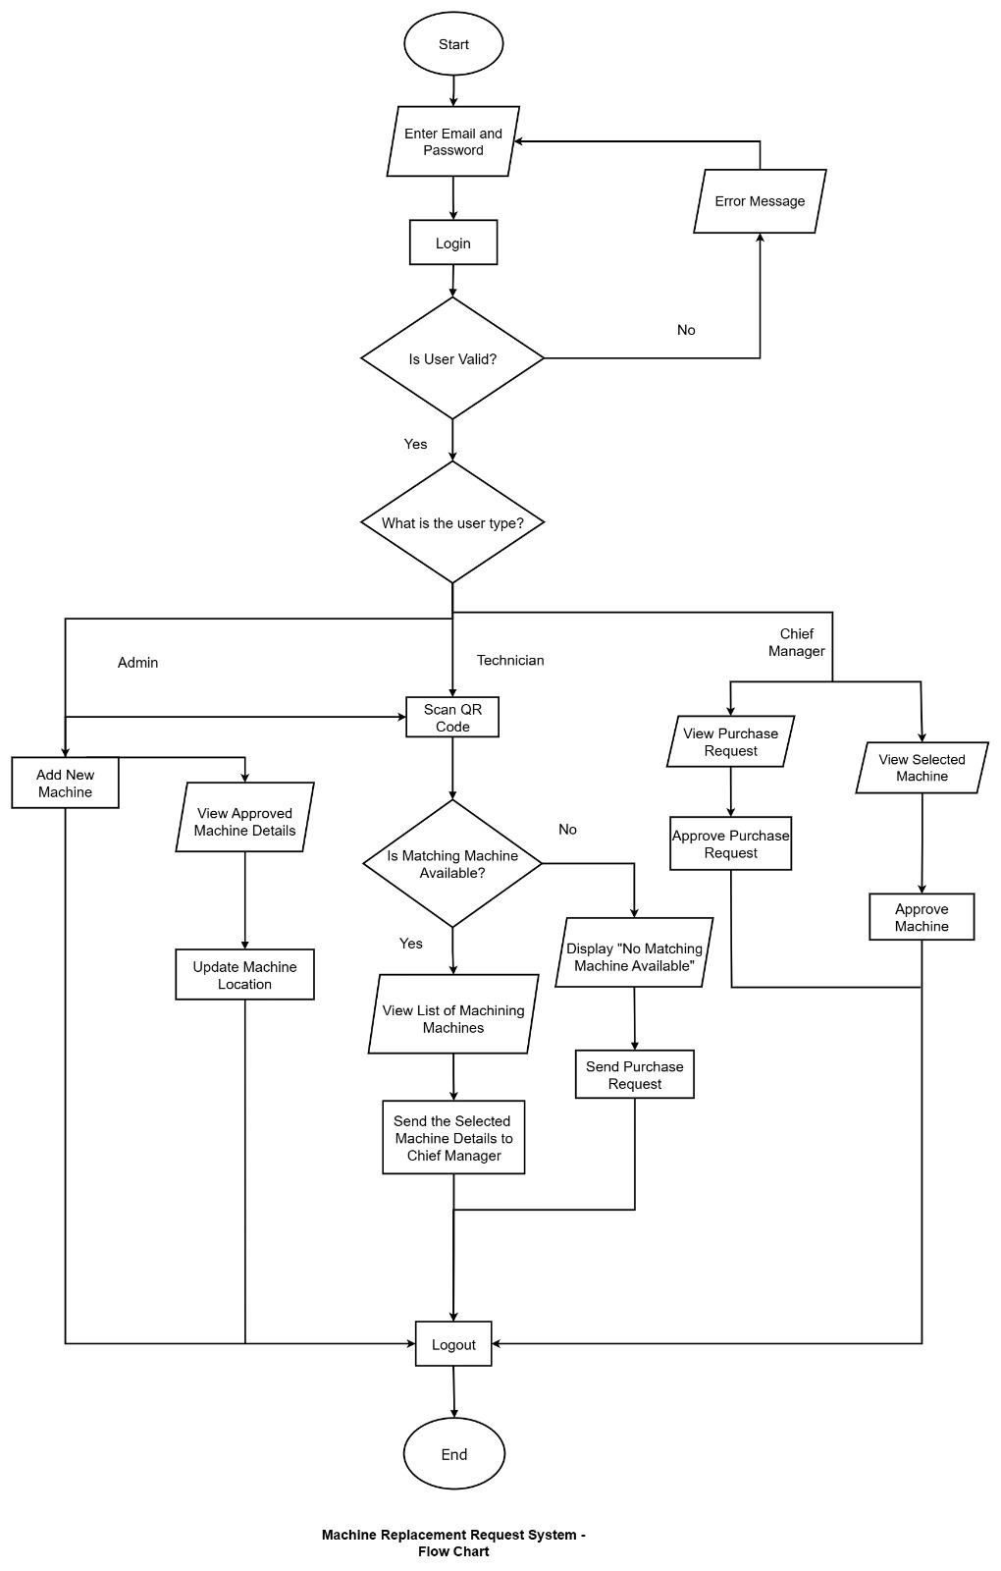
System Overview
Page | 9

Slide 10
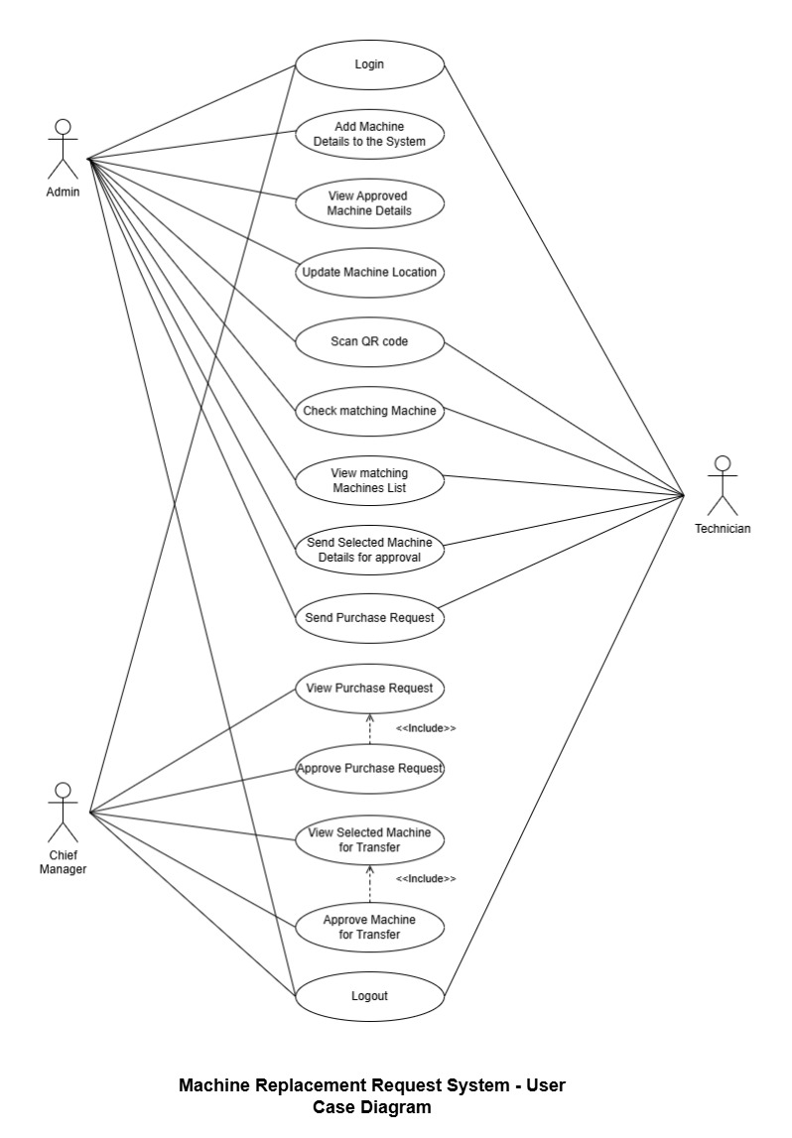
Use Case Diagram
Page | 10

Slide 11
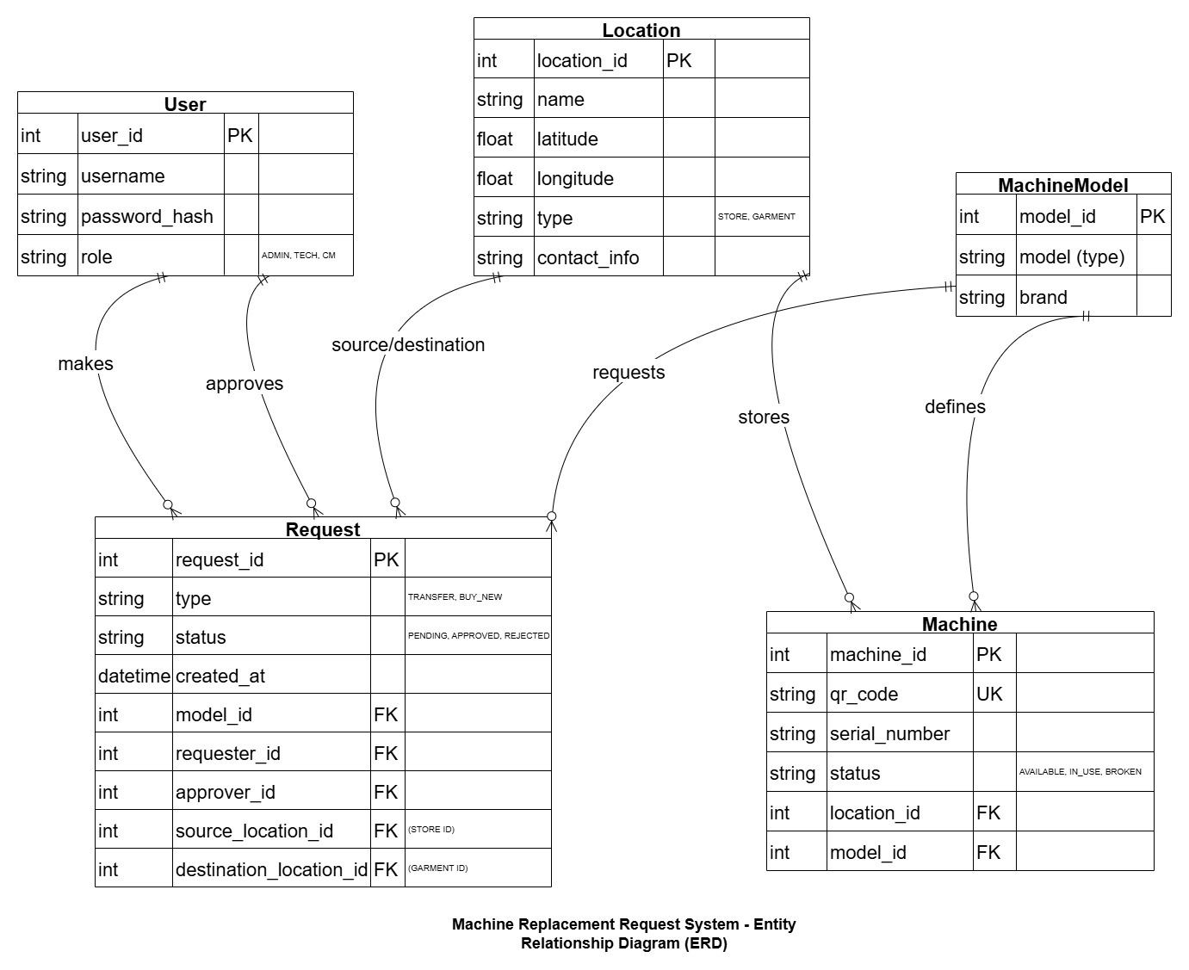
Entity Relationship
Digram
Page | 11

Slide 12
Tools & Technologies
Backend
Frontend
Java (Spring Boot)
React.js
RESTful API, business logic, security
Interactive UI, QR scanner integration
DevOps & Tools
Database
Docker
PostgreSQL
Containerization & deployment
Relational DB, spatial queries
Git
Version control & collaboration
pgAdmin
Database management GUI
Page | 13

Slide 13
Project Timeline — Gantt Chart
Wk 1
Wk 2
Wk 3
Wk 4
Wk 5
Wk 6
Wk 7
Requirement Analysis
System Design
Database Setup
Backend Development
Frontend Development
QR Integration
Testing & QA
Documentation
Final Review
Page | 15

Slide 14
Thank You
Questions & Discussion

